Slide 1
Genome Assembly and Differential Expression of Enterococcus faecium E745
Paper I – RNA-seq and Tn-seq reveal fitness determinants of vancomycin-resistant Enterococcus faecium during growth in human serum (Zhang et al. 2017)
Notes:
So I will tell you about paper 1 – where we do genome assembly and differential expression of enterococcus faecium E745 to find the fitness determining genes in human serum.

Slide 2
Overview
01
Introduction
Background and aim of study
05
Synteny
Aligning different species
02
Preprocessing
Quality control, trimming
06
Transcriptomics
Mapping, counting, comparing RNA
03
Assembly
Different assemblers
07
Results
04
Annotation
Finding genes
08
Conclusions

Slide 3
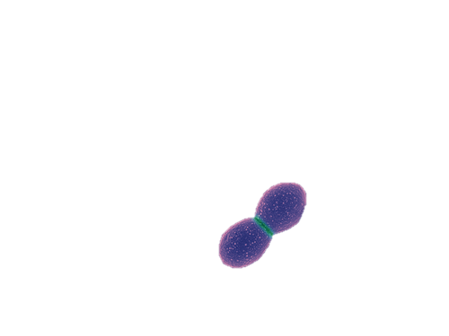
Enterococcus faecium
Multi-resistant
Hospital disease
Urinary tract and bloodstream
Strain: E745 from rectal swab (Clade A-1, NL)
Photo: https://www.indiamart.com/proddetail/enterococcus-faecium-probiotics-8411604530.html
Notes:
A short background. Enterococcus feacium is normally located in the gastrointestinal tract but it is
≠
one of the multi-resistant bacteria that are often found in hospitals infecting the already sick patients.
There it can be found in wounds, and urinary tract (often after inserting a catheter) but also in the bloodstream which obviously is really bad.
≠
The strain we are looking at in this paper was collected from a rectal swab from an outbreak in the Netherlands and is called E745.

Slide 4
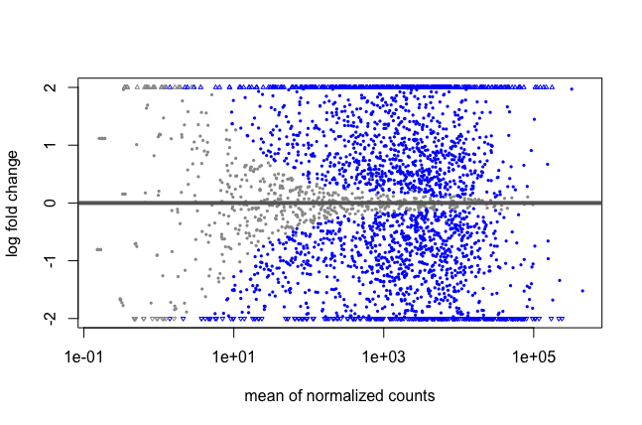
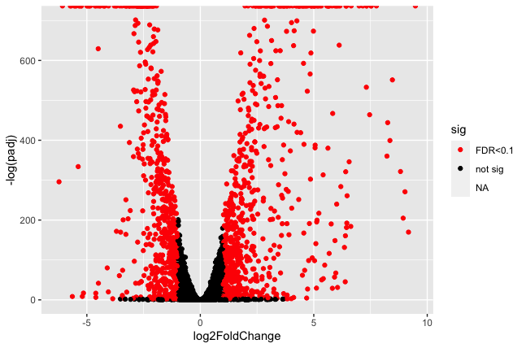
Aim
Identify genes responsible for growth in human serum
Notes:
The aim of this study is to try and reproduce the experiment from the article and find which genes of this strain of E faecium that make it possible to survive in the otherwise sterile environments such as in human serum and in the urinary tract.
These genes could be potential targets for new antibiotics.

Slide 5
Data
DNAseq from:
PacBio RSII
illumina HiSeq 2500
NanoPore MinION 2D
RNAseq (and Tn) from medium and serum:
illumina HiSeq 2500
Notes:
I received DNA sequence data from PacBio, illumina and Nanopore.
≠
and RNA trancripts from illumina. From bacteria grown in Serum and bacteria grown in rich medium. BHI – brain heart infusion broth.

Slide 6
02
Preprocessing
Quality Control with
FastQC
Trimming with
Trimmomatic

Slide 7
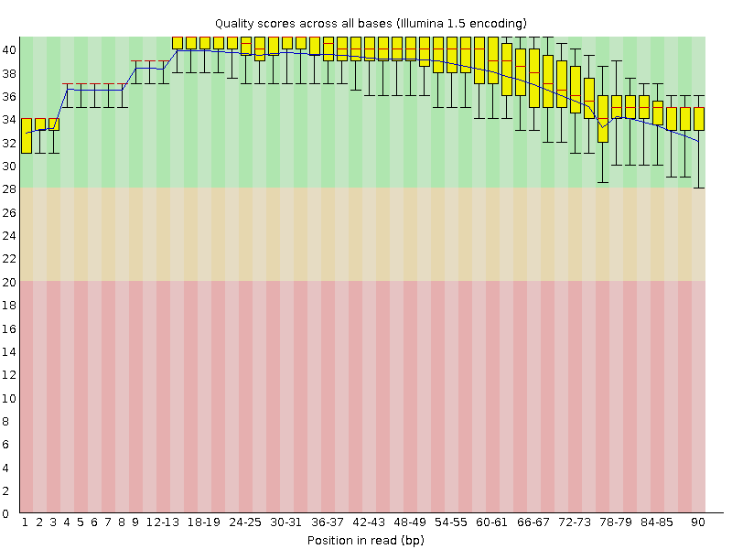
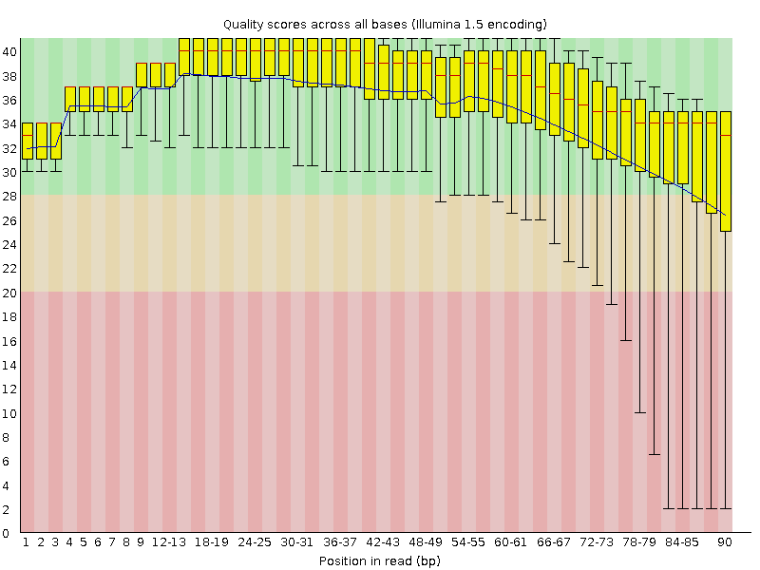

FastQC example
Illumina DNA read 1
Illumina DNA read 2
Before trimming
No significant difference – files already trimmed
After trimming
Notes:
So this is just one example. illumina DNA forward and reverse raw reads.
Before trimming and after,
≠
Some reads were trimmed away but there was no significant difference since the files had already been trimmed, and this was the same with all the ”raw reads”for both DNA and RNA.
≠
So I just continued with the original files.

Slide 8
03
Assembly + evaluation

Slide 9
Assemblers
Canu
Spades
Pilon
Canu_PacBio
+
BWA aligned illumina + NanoPore
PacBio
illumina
illumina + NanoPore
illumina + PacBio
illumina + NanoPore + PacBio
Notes:
So I used Canu for de novo assembling the long PacBio reads, which also does some quality check and trimming. Then I did de novo assembly with spades of the illumina reads and in combination with both NanoPore and PacBio reads. And then I combined the illumina and NanoPore raw reads with my pacbio assembly, after mapping them onto the assembly using BWA index and mem

Slide 10
Evaluation
BCF
MUMmerPlot
QUAST
Notes:
To evaluate my different assemblies I used BCF, MUMmerplot and Quast. I will just show you some Quast statistics.

Slide 11
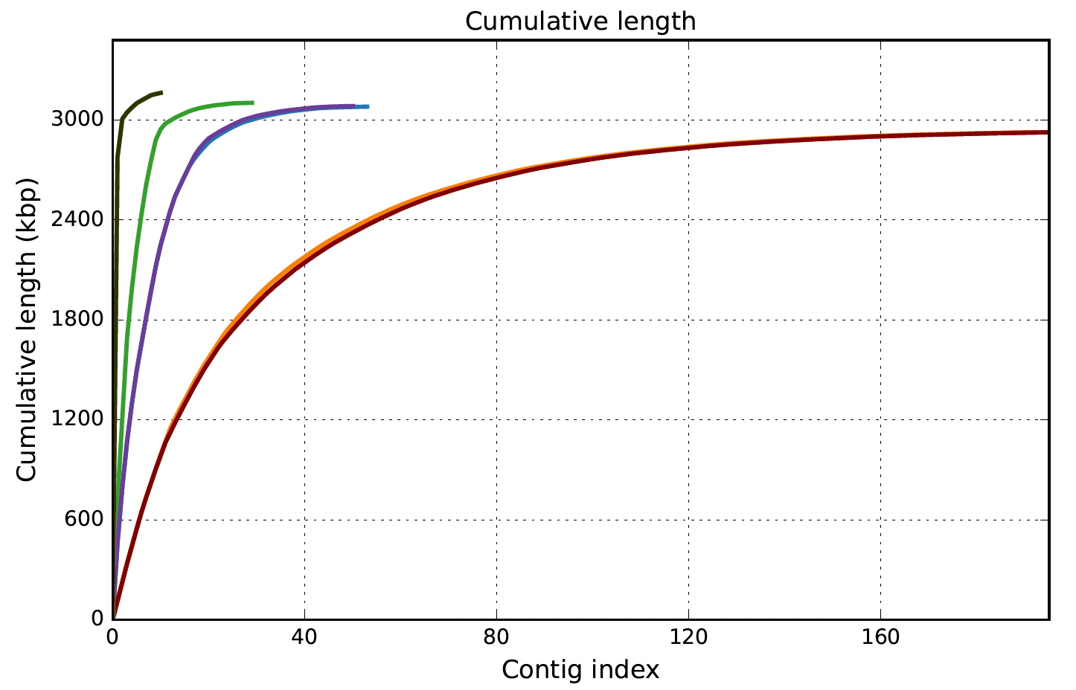
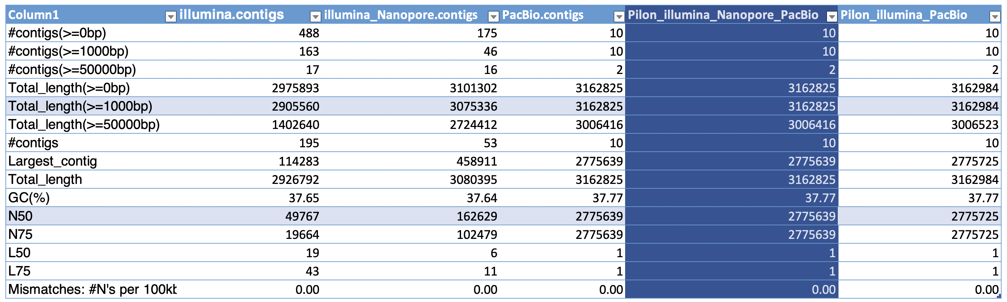
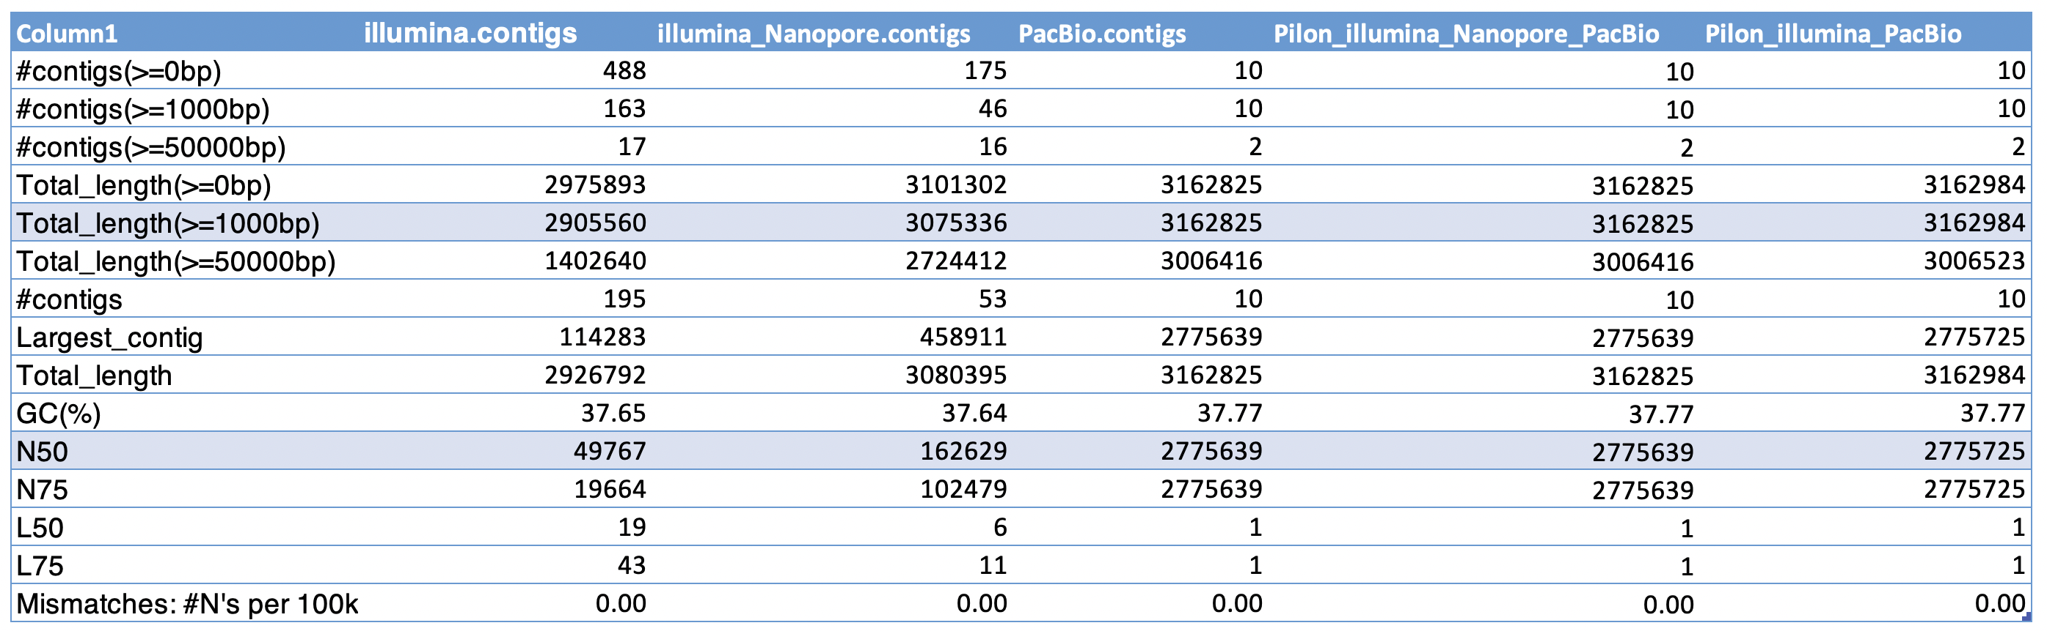
QUAST report
Article:
1 circular chromosome: 2.764Mb
6 plasmids: 9.3 - 223.7kbp
3095 predicted coding sequences
Notes:
In this case I didn’t need a reference genome with Quast but I have some numbers from the article, and I was expecting to get at least 7 long contigs, 1 chromosome and 6 plasmids. So I am quite happy with these numbers, my N50 is high and it seems like it managed to assemble the whole genome when based on the PacBio reads.
Really there is no difference between the canu and pilon assemblies here
≠
but I kind of like the thought that all the reads were considered so I continued the project with the pilon assembly.

Slide 12
04
Annotation Prokka
Notes:
After deciding on my perfect genome I did the structural and functional annotation by using Prokka

Slide 13
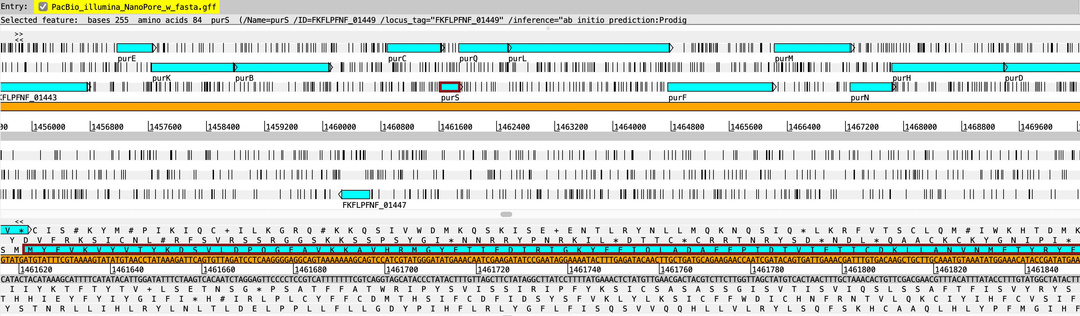
Prokka annotation
Findings:
rRNA
tRNA
tmRNA
CDS (3126)
(Artemis)
Notes:
So now we have the location of the different RNA and coding sequences as visualized in artemis.
Prokka found 3216 coding sequences, in the article they talk about 3095, i don’t know why there is a difference, maybe because there are more known homologues in the database today? Or maybe I have some extra regions in my assembly?
I was quite surprised at how fast prokka was able to find all these regions of interest. And the names of most of the coding sequences.

Slide 14
05
Synteny Align, compare
Notes:
After I had my interesting regions I wanted to do some comparative genomics and look at relatives.

Slide 15
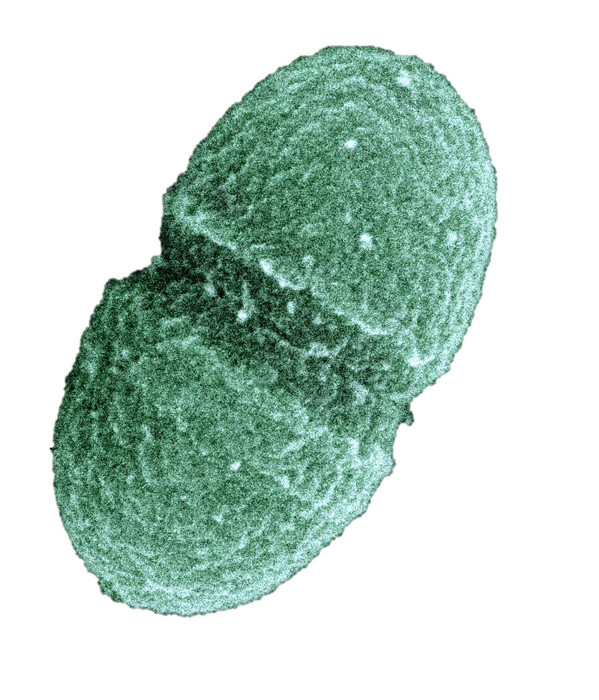
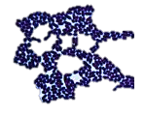
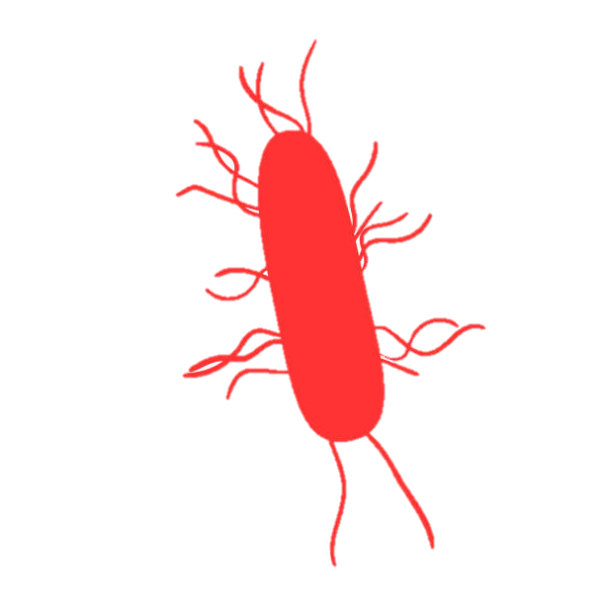
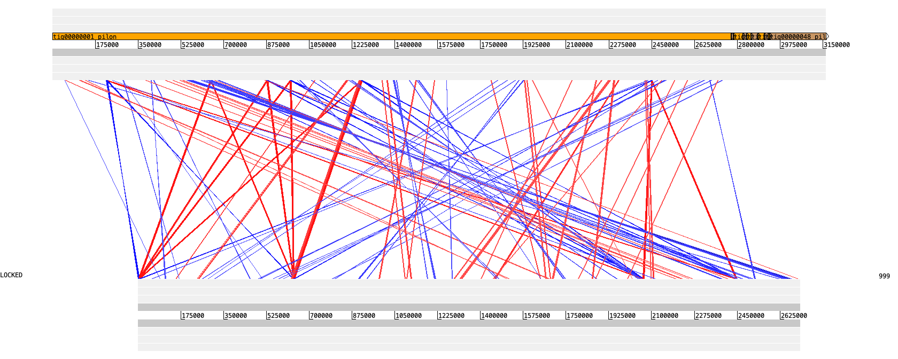
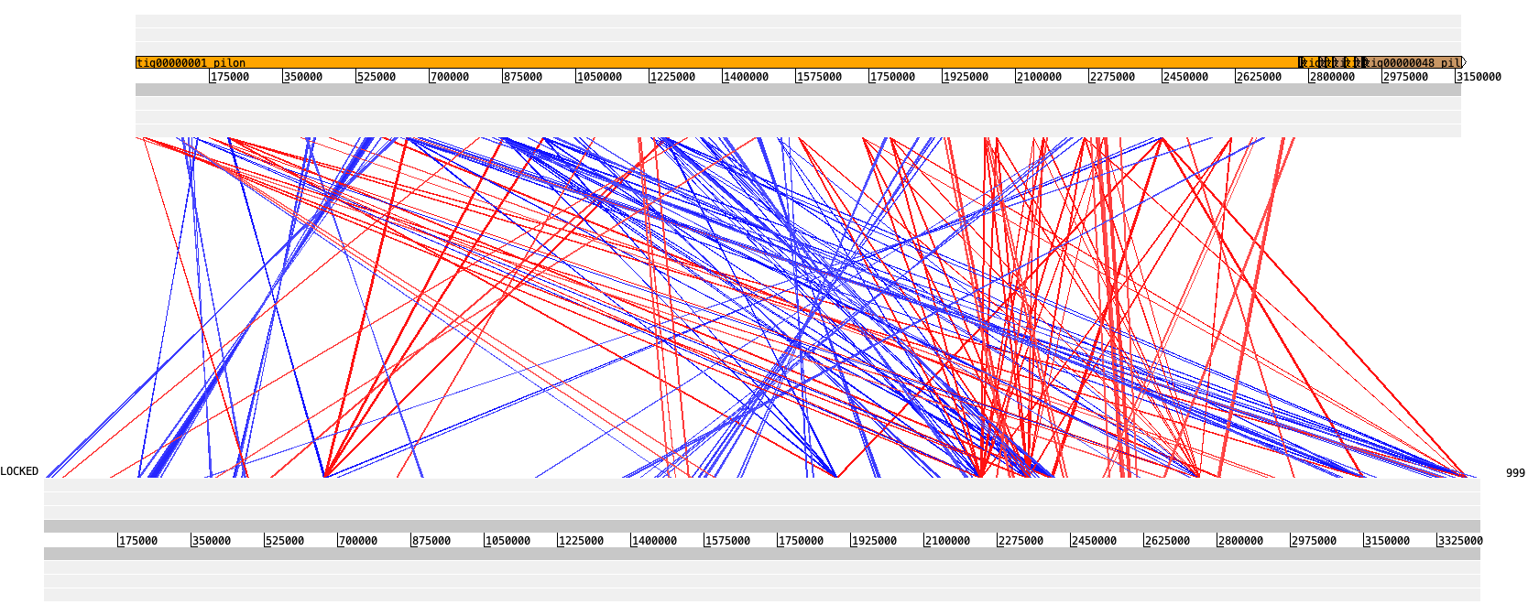
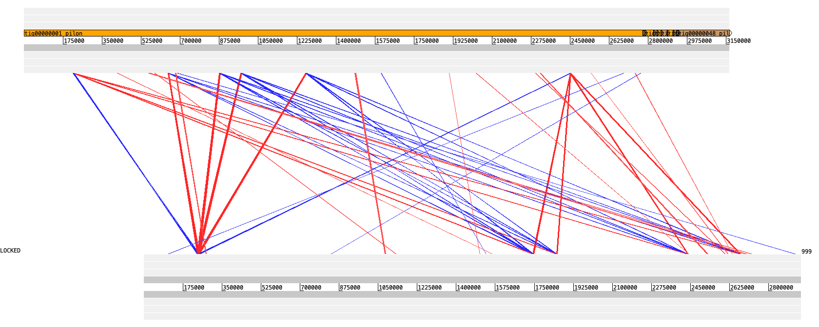
Synteny – E. faecium
E. faecalis
E. casseliflavus
L. monocytogenes
blastn alignment of whole genome. Visualized with Artemis ACT
(Photos: https://www.google.com/url?sa=i&url=https%3A%2F%2Fen.wikipedia.org%2Fwiki%2FEnterococcus_faecalis
https://microbe-canvas.com/Bacteria.php?p=1239
https://www.google.com/url?sa=i&url=https%3A%2F%2Fwww.istockphoto.com%2Fphotos%2Flisteria-monocytogenes)
Notes:
So first I downloaded the reference genomes of three different related species from NCBI. According to NCBI E. faecalis was the closest relative, and E. casseliflavus and Listeria monocytogenes are more distant.
I did whole genome alignment with my prokka annotated assembly. and visualized the comparisons using ACT from artemis. and here it looks like E. casseliflavus is more closely related than faecalis.
Here we see some regions that have been inverted and translocated.
I expected more synteny similarity with the other enterococcus and was in general quite surprised by the results, but again we do know that bacteria have high evolution and recombination rate.
So I also decided to download a different strain of E. faecium to compare with.

Slide 16
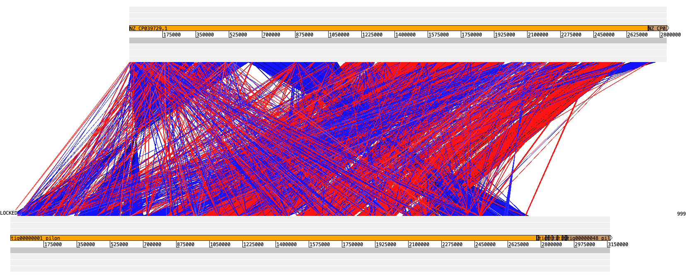
Synteny
E. faecium E745 vs Reference E. faecium
blastn alignment of whole genome. Visualized with Artemis ACT
Notes:
And here we obviously get many more matches but we do see some of the same patterns in inversions of some large regions, which is interesting.
Also it seems like my plasmids are new, they haven’t matched at all with the E. faecium representative genome.

Slide 17
06
Transcriptomics Mapping, counting reads, compare E. faecium in Medium vs Serum

Slide 18
RNA seq (Medium vs Serum)
BWA (index, mem)
Samtools (sort, index)
DeSeq2
RStudio
HTSeq count
Mapping RNA reads onto genome assembly
Count number of
transcripts mapped
to each gene
Differential expression
Plots
Notes:
So first I mapped the RNA seq transcripts unto my genome assembly using BWA and Samtools, and then I counted the number of transcripts mapped to each gene using HTSeq, and then I did the differential expression and plotting in RStudio using DeSeq2.

Slide 19
07
Results

Slide 20
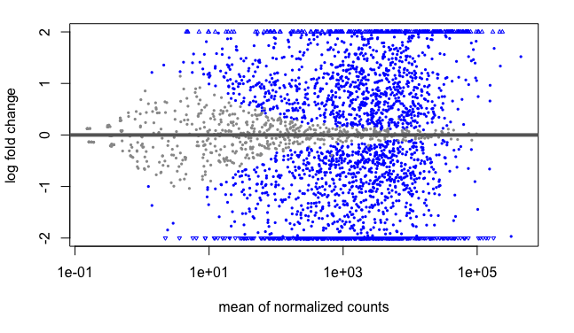
DeSeq2
3216 transcription units. 1216 units (40%) were upregulated and 1212 units (40%) were down-regulated.
(RStudio plots. Log fold change vs LFC shrinkage)
Notes:
I found out from HTSeq that I had 3216 unique transcription units, that number is 3217 in the article, so that is close enough.
We have 3 treated samples (grown in serum) vs 3 untreated samples (from the rich medium)
and pretty equal amount of up vs down regulated units.

Slide 21
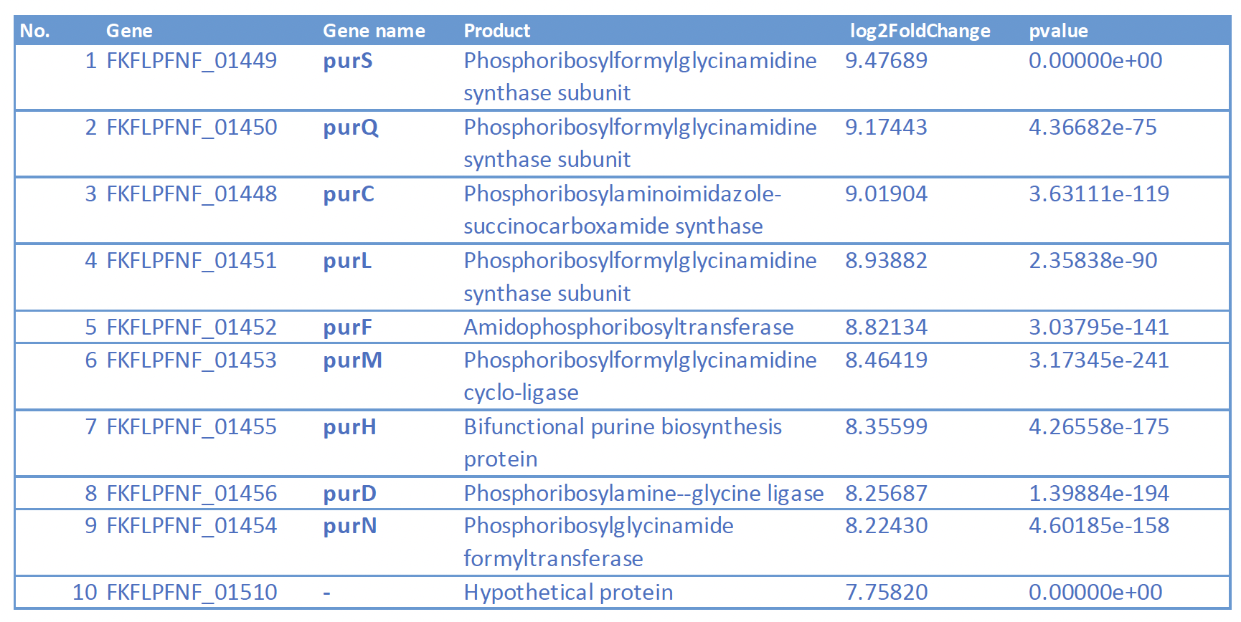
DeSeq2
(RStudio plot. After false rate discovery adjustment)
Notes:
After removing the false discoveries, and plotting the log2 fold change.
We can fish out
≠
these top 10 genes with the greatest expression difference between these two conditions.
And as you can see in this table all these genes with the highest log2 fold change, seem to follow a pattern in their functions. Synthesis

Slide 22
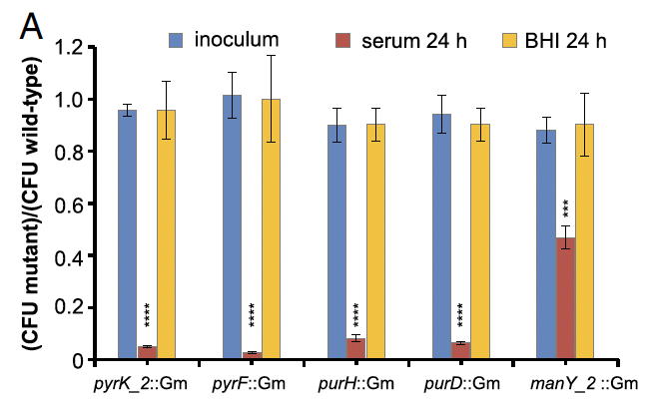
Example of Transposon effect
Transposons in these genes: pyrK, pyF, purH, purD, manY
Showing number of mutant survivors after 24h in serum and medium
Significant negative effect on viability in serum
Diagram from Zhang et al. 2017
Notes:
I did not have time to investigate the transposon mutants. But I just wanted to show a quick example from the article.
So the question we want to answer is if we destroy the function of these genes will the bacteria still be able to survive?
So they did in vivo testing, by growing the mutants in zebrafish embryos and then after moving the mutants to medium and serum they checked the survival rate after 24h
Transposon mutants in these genes have huge negative effect in growth in serum but no effect is observed in the medium culture.

Slide 23
Conclusion
Good targets:
Genes involved in the nucleotide synthesis pathway: purS, purQ, purC, purL, purF, purM, purH, purD, purN (and carbohydrate metabolism manY, manZ. Tn-seq)

Slide 24
THANK YOU

Slide 25
References
Zhang X, de Maat V, Guzmán Prieto AM, Prajsnar TK, Bayjanov JR, de Been M, Rogers MRC, Bonten MJM, Mesnage S, Willems RJL, van Schaik W. 2017. RNA-seq and Tn-seq reveal fitness determinants of vancomycin-resistant Enterococcus faecium during growth in human serum. BMC Genomics 18: 893.
https://canu.readthedocs.io/en/latest/tutorial.html#canu-the-command
https://cab.spbu.ru/files/release3.14.0/manual.html
https://support.illumina.com/bulletins/2016/04/fastq-files-explained.html
http://bioconductor.org/packages/devel/bioc/vignettes/DESeq2/inst/doc/DESeq2.html#htseq-count-input

